Slide 1


Gavin Campbell, Eric Gulotty, Brandon Wong,
Bella Davies, William Li
Notes:
William

Slide 2
Overview
01
02
03
04
05
06
Introduction
Data Description
PCA Analysis
Methodology
Results
Conclusions
Notes:
William

Slide 3
01
Research Question
As a small business, which factors are most impactful when considering the approval of a loan and the likelihood of it being paid off in full?
Notes:
William

Slide 4
—Barack Obama
Oct 28, 2009
66% of New Jobs Created
“Small Businesses are the backbone of our economy and the cornerstones of our nation’s promise ”
Notes:
William (Can I take this slide just so it ties into my intro to what a SBA loan is - Eric) Sure!! - Will

Slide 5
What is an SBA Loan?
Government Guaranteed
Low Interest
Long Repayment Terms
Partially (up to 85%) guaranteed by US gov.
Benefits borrowers who may pay higher rates elsewhere
Can result in smaller monthly payments for businesses
Accessible
Specific Requirements
Use Cases
Designed to be less restrictive than other loan types (as long as the business meets requirements)
Businesses must be for profit, failed to have qualified for reasonable terms for a traditional loan
Working capital, equipment purchase, office essentials, business acquisitions
Notes:
Eric

Slide 6
Data Description
Founded in 1953
Primary motive to help job creation
SBA
Case study
Approve or deny certain loans
Motives
US SBA
899,164 observations
27 variables
Data Description
Help entrepreneurs
What parts of personal business are most impactful
Our Motive
Notes:
START GAVIN SECTION

Slide 7
02
Data Preprocessing Steps
Preprocessing Steps
Dropping uninformative columns:
Loan ID, business name, city, zip code, date
Clean Currency Symbols
Clean dollar figures to numerical values
Dummy coding
RevLineCr, Franchise, UrbanRural, NewExist, LowDoc, MIS_Status
20 NAICS Industry Codes (agriculture, utilities, information, etc)
Variable creation
Recession = 1 if between Dec 2007 - Jun 2009, 0 otherwise

Slide 8
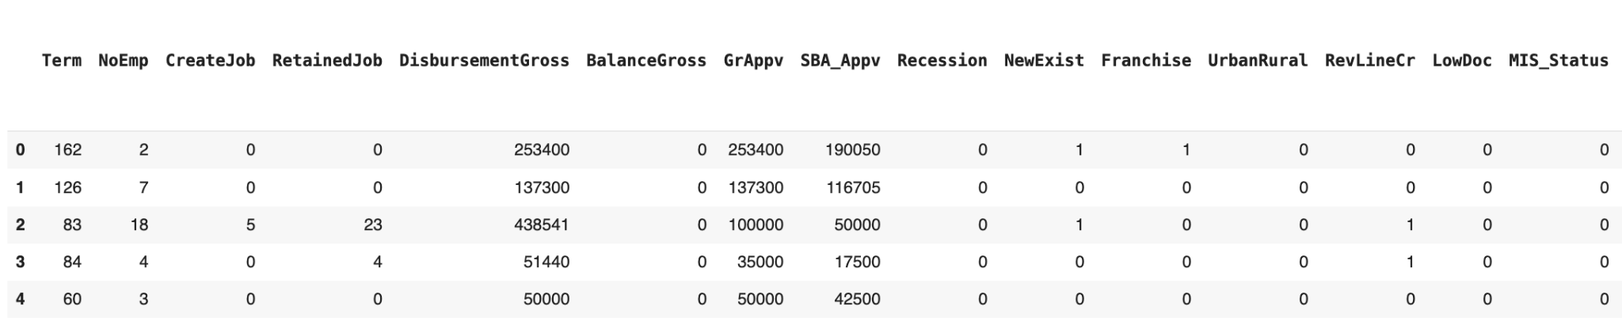
Final Cleaned Dataset
Metric Variables
Categorical Variables
Term DisbursementGross Recession RevLineCr
NoEmp BalanceGross NewExist LowDoc
CreateJob GrAppv Franchise MIS_Status
RetainedJob SBA_Appv UrbanRural 20 NAICS Codes…
Endstate - 35 variables, 547,698 observations

Slide 9
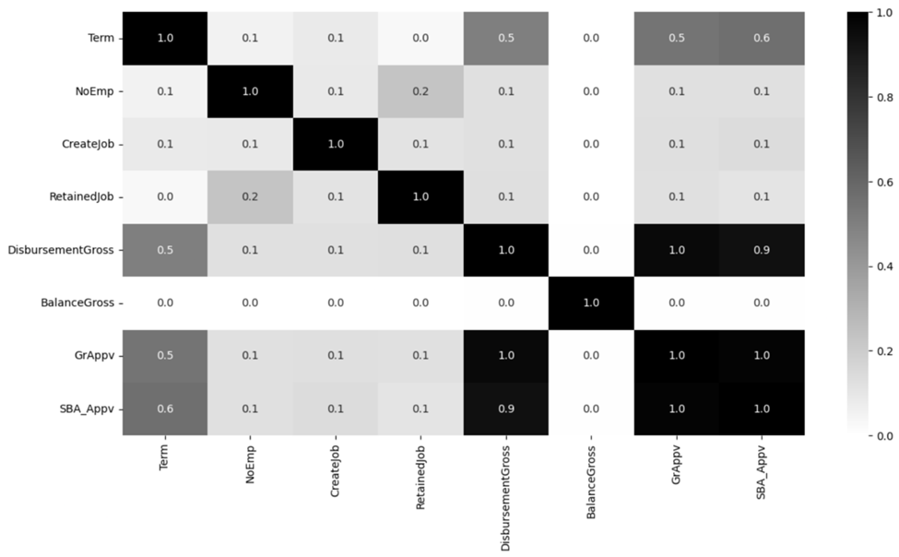
Correlation Between Metric Variables

Slide 10
03
PCA Failed??
PCA decreased model performance
Notes:
Learning points
Was it appropriate …
Who do you think will pay in full ?? Raise of hands

Slide 11
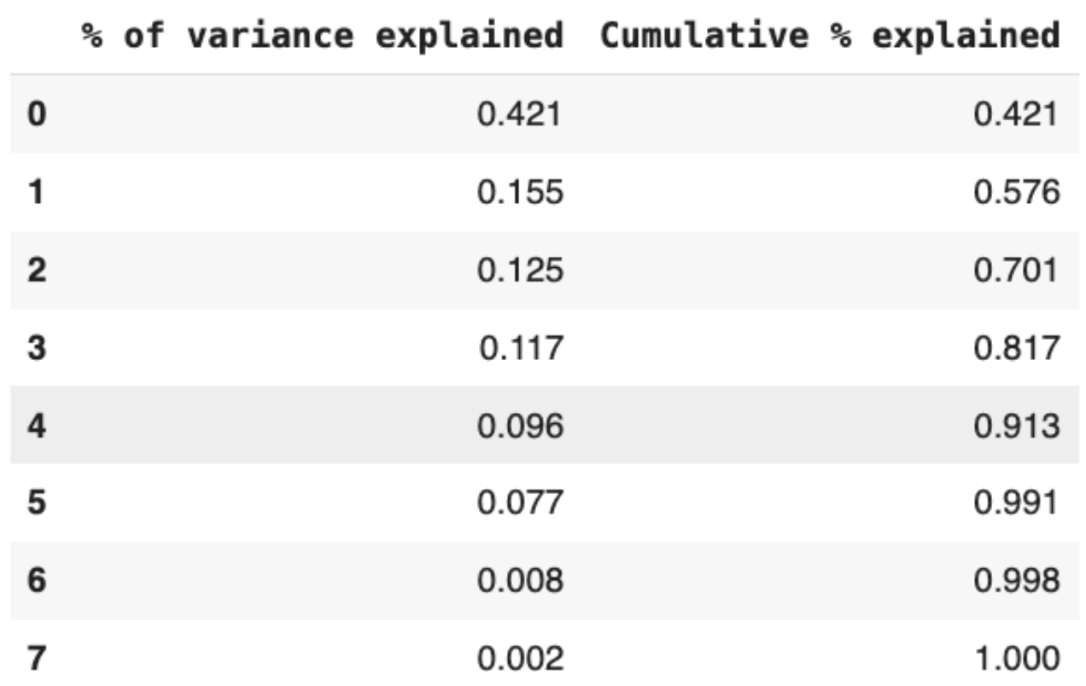
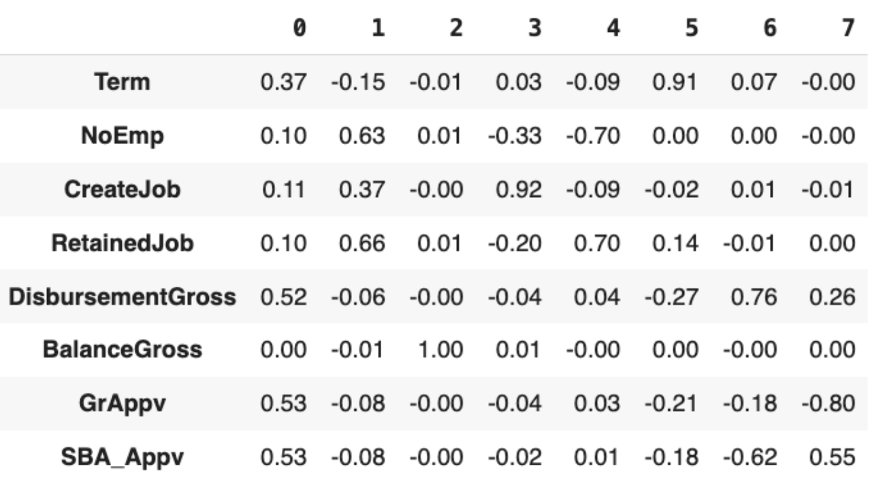
Analysis PCA
PC 0 - Propensity for the loan to be larger, explains 42.1% of the variance
PC 1 - Propensity for the borrowing business to be larger, explains 15.5% of the variance
Together, PC 0 and PC 1 explain 57.6% of the cumulative variance. We also tried using 3 and 6 PCs.

Slide 12
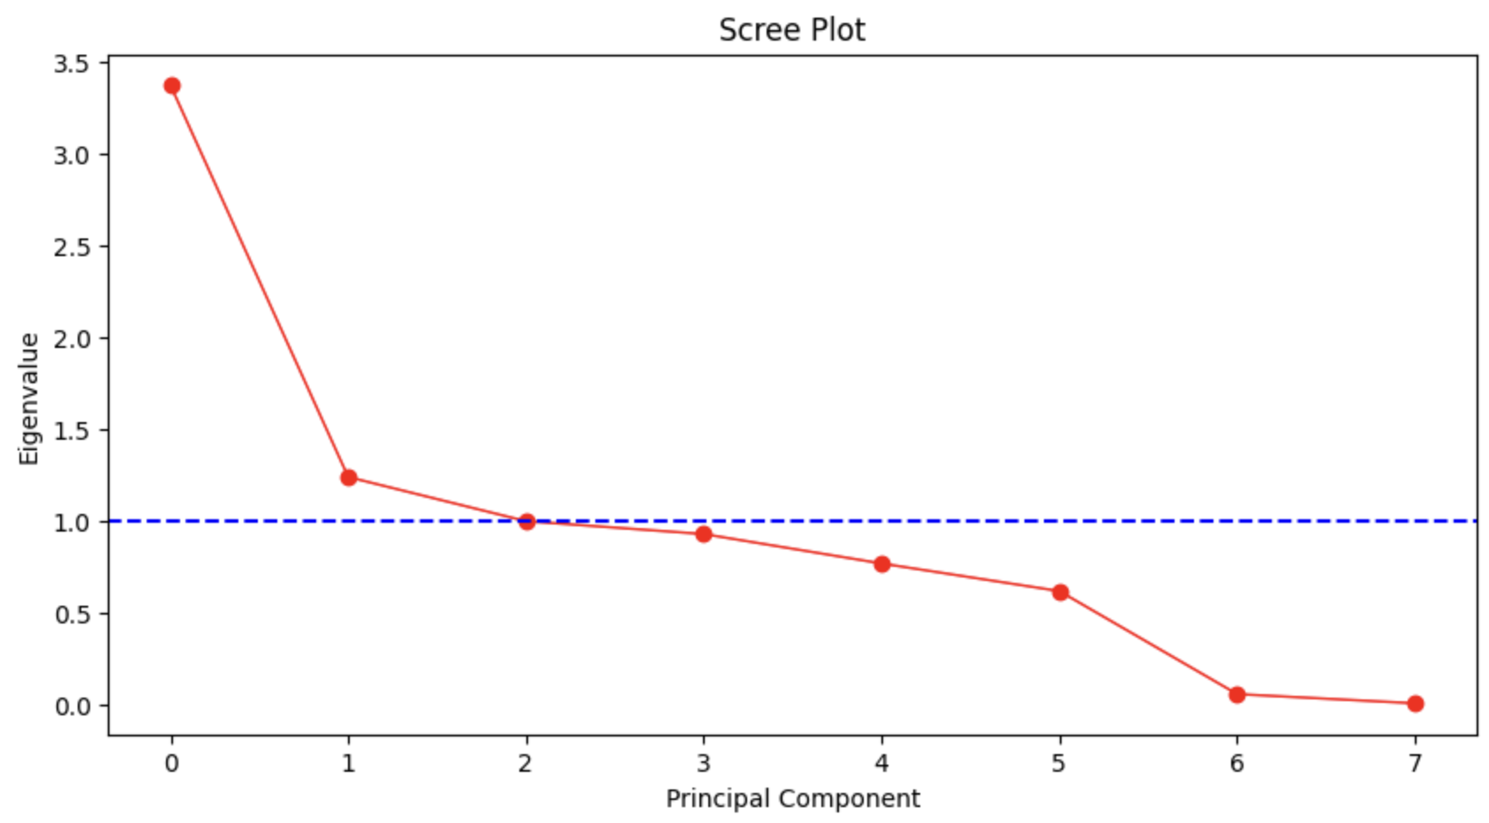
Showcase Before and After PCA
Using the point of inflection at 1, we will keep Principal Component 1 and 2. These are add these to the training dataset, replacing the metric variables to reduce dimensionality of the data

Slide 13
Discussion on PCA
Decreased Performance
Lost Information
As there are only 8 metric variables, out of 35 in our data, these are some of the top features. Replacing them results in lower feature importance and information lost.
All models had worse performance using PCA than without using it. Therefore we chose to keep the original metric variables and not use the PCs.
Notes:
END OF GAVIN SECTION

Slide 14
04
Modeling / Methodology
Notes:
Brandon

Slide 15
Model Analysis
 | Test Accuracy | Improvement from Baseline
Naive Baseline | 76.1% | 0%
Logistic Regression | 76.1% | 0%
Logistic w/ Optimal Cutoff | 80.5% | 4.4%
Decision Tree w/o Pruning | 89.8% | 13.7%
Reduced Decision Tree | 84.7% | 8.6%
Decision Tree w/ Grid Search | 92.8% | 16.7%
Random Forest | 91.2% | 15.1%
Random Forest w/ Grid Search | 91.3% | 15.2%
Gradient Boosting | 93.4% | 17.3%
Notes:
Brandon
Possible question might be about the values tried in grid search and best parameter values found for dtree
(best max_depth = 30, min_impurity_decrease=0, min_samples_leaf=30)
(tried max_depth = 20,30,50, min_samples_leaf=20,30,50,100,, min_impurity_decrease=0,0,1,0.01

Slide 16
Logistic Regression: 4.4% Improvement
Accuracy: 80.5%
Recall: 50.8%
Precision: 61.2%
F1 Score: 55.5%
Best Cutoff: 0.3
Possible Reasons for Poor Performance
Dataset has a large imbalance leading to bias for the majority class (majority paid vs defaulted)
Assumes linearity between the log odds of dependent variable and the independent variables
Works better with mostly metric variables, and our dataset is mostly categorical

Slide 17
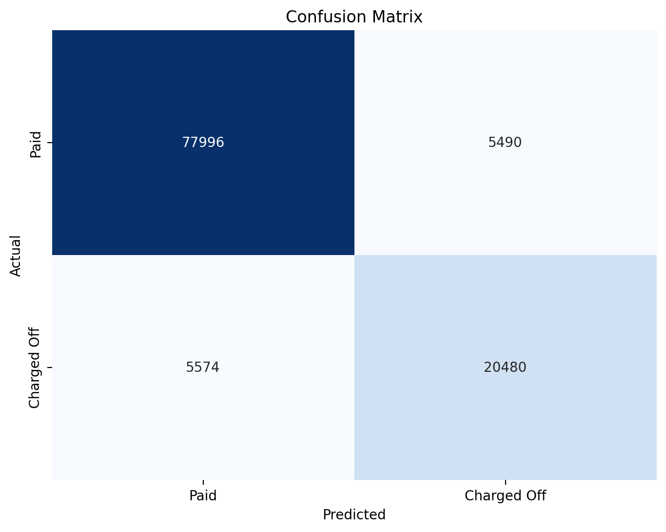
Decision Tree with Grid Search: 16.7% Improvement
Accuracy: 92.8%
Recall: 84.3%
Precision: 85.7%
F1 Score: 85%

Slide 18
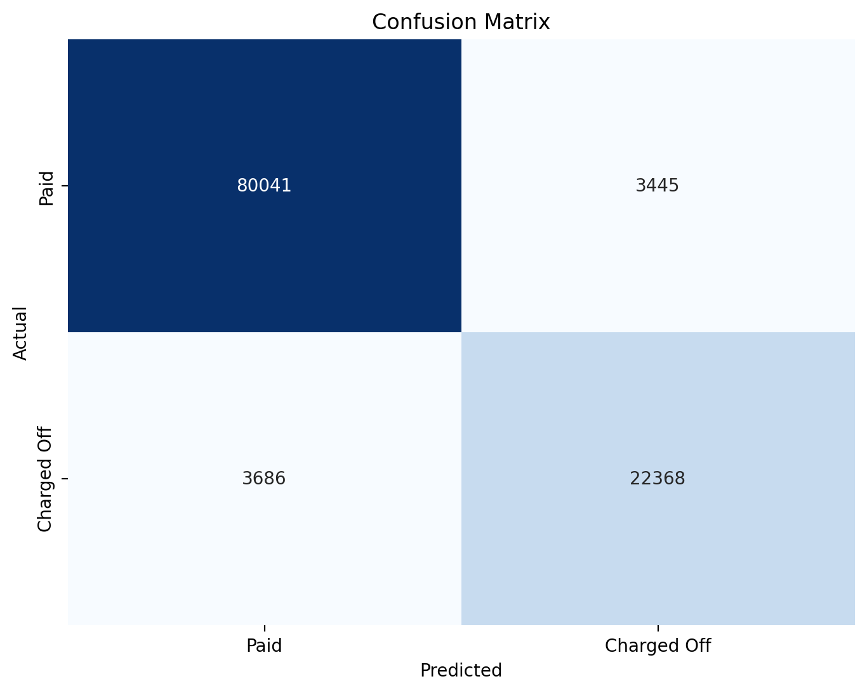
Gradient Boosted Tree: 17.3% Improvement
Accuracy: 93.4%
Recall: 85.8%
Precision: 86.6%
F1 Score: 86.2%

Slide 19
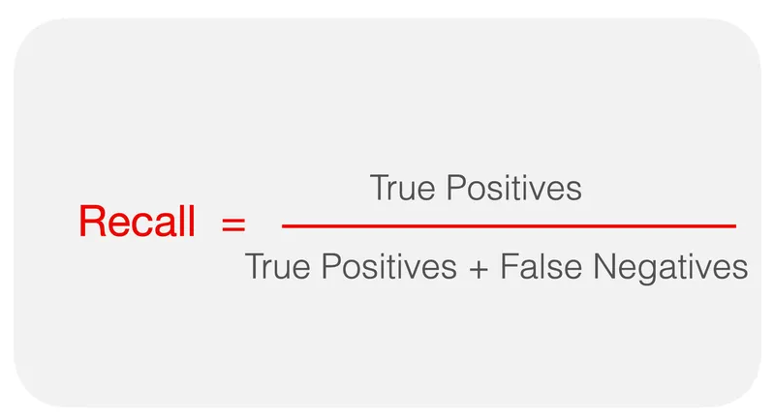
Model Evaluation
Goals of Classification
Identifying as many potential defaults (charged off) as possible
Risk Management: Fewer surprises in terms of unexpected defaults, better false positive than false negative
Evaluation
High Accuracy
Emphasize Recall
False Negatives (predicted Paid, actually Charged Off) are more costly, but also try to reduce false positives
Mitigate imbalanced class (focus on True Positives)

Slide 20
Final Chosen Model - Decision Tree with Grid Search
Why?
Top 2 models in accuracy
Around 1% difference in Recall than a Gradient boosted tree, but allows for more interpretability with tree’s decision paths.
Accuracy: 92.8%
Recall: 84.3%
Notes:
Brandon

Slide 21
05
Results
Notes:
William

Slide 22
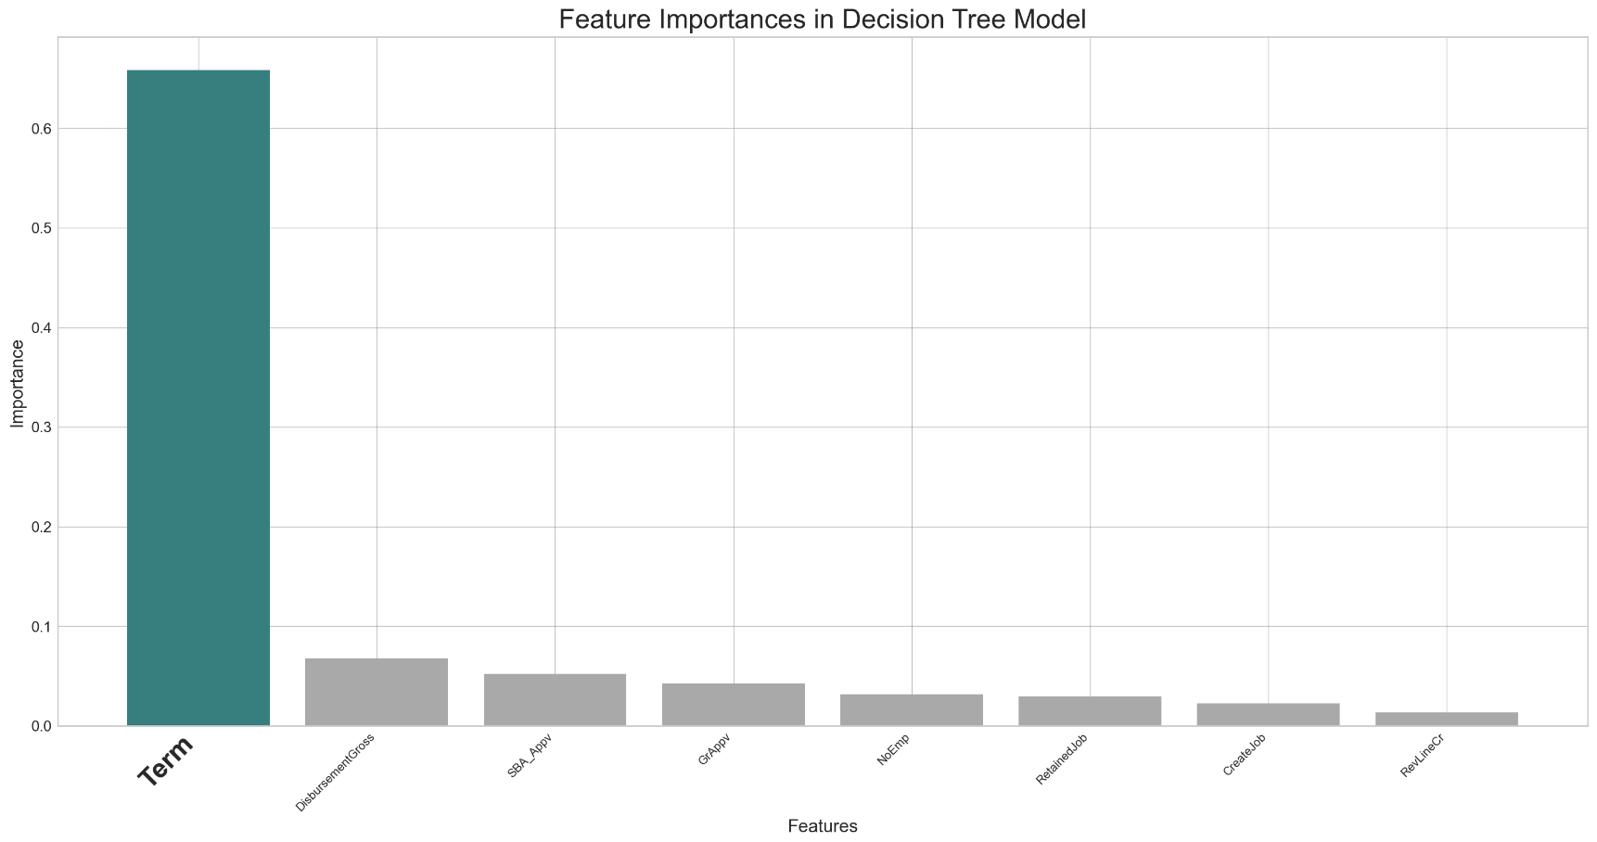
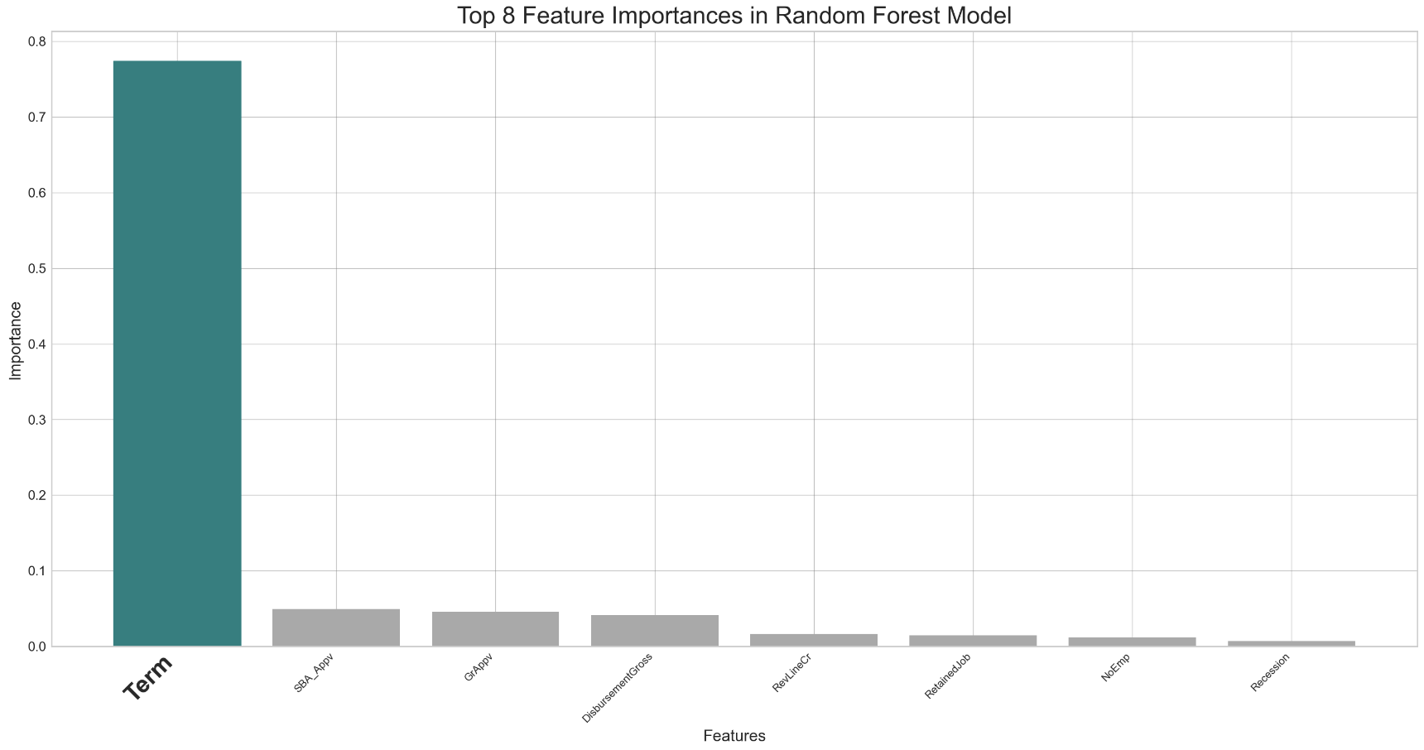
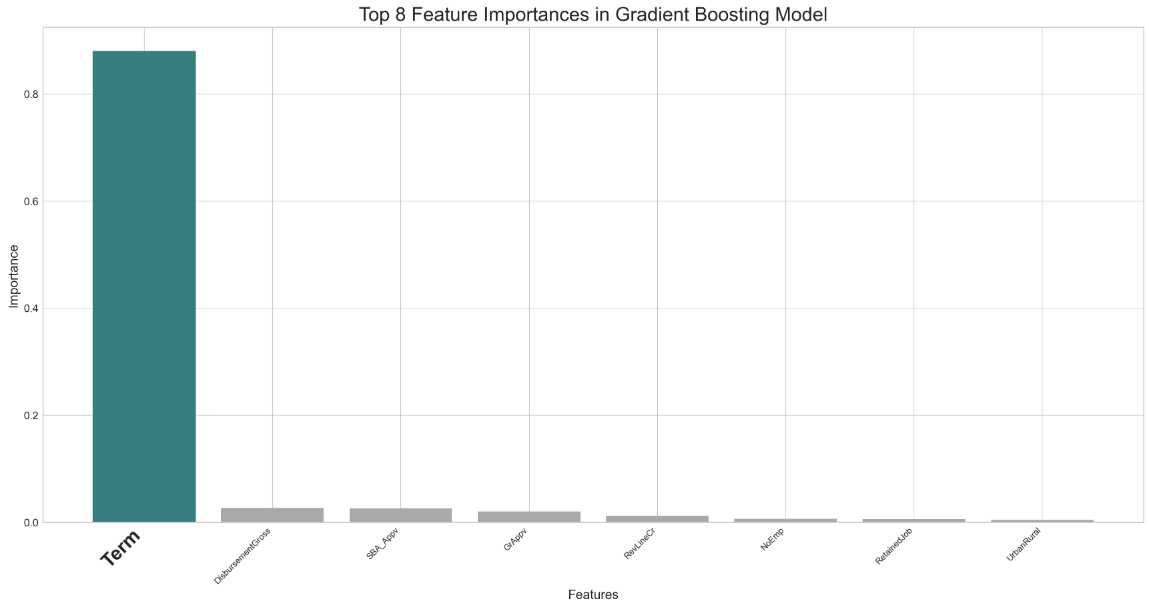
#1. Term
Top Feature for Predicting Loan Defaults
Decision Tree
Random Forest
Gradient Boosting
Notes:
William

Slide 23
Important Features
Feature 1: Term
Feature 4: Gr_Appv
Loan term in months
Gross amount of loan approved by bank
Feature 2: Disbursement Gross
Feature 5: RevLineCr
Amount disbursed
1 = Revolving Line of Credit, 0 = Not
Feature 3: SBA_Appv
Feature 6: NoEmp
SBA’s guaranteed amount of approved loan
Number of business Employees
Top 4 features are identical in decision tree and gradient boosted tree
Notes:
William

Slide 24

Testing the Model on an Example Business
Retail trade
8 business employees
2 jobs created
6 jobs retained
Existing business
Not a franchise
Urban location
These values were selected by examining distributions of variables and selecting the most common business
Notes:
bella

Slide 25
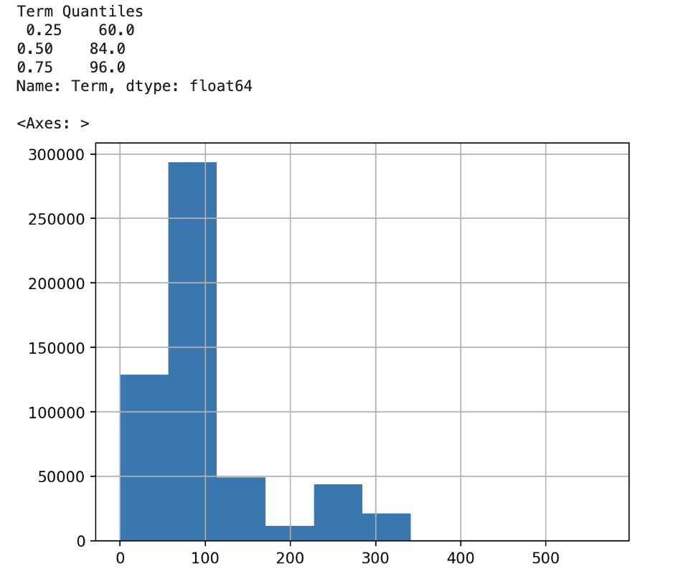
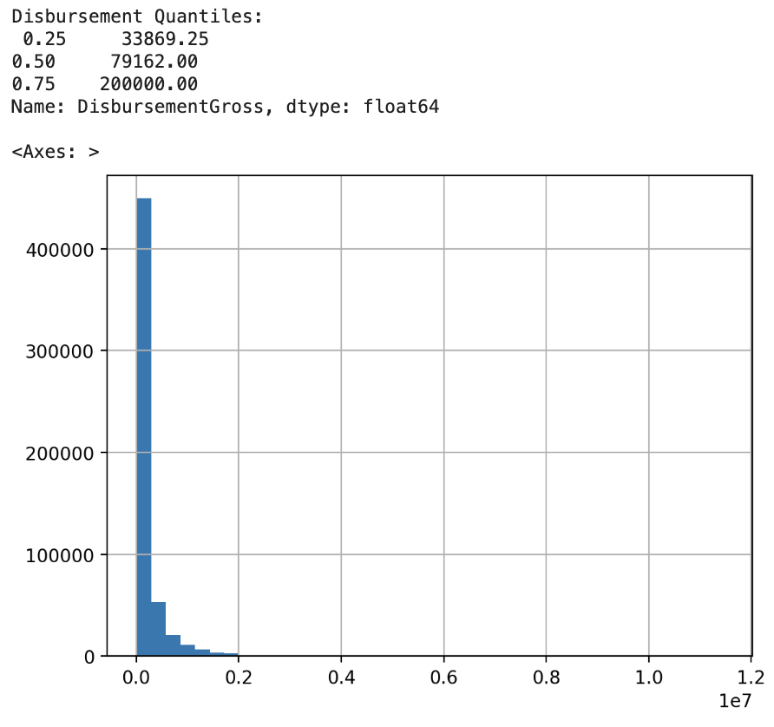
Deciding Feature Values to Test the Model On
Which loan is more likely to be paid in full?
(testing loan term & disbursement amount features using quantile values)
Notes:
bella

Slide 26
Decision Tree Predictions
Loan Term | Disbursement | MIS_Status | Dtree Probability
60 months | $34,000 | Paid in Full | 1.00
60 months | $80,000 | Paid in Full | 0.97
60 months | $200,000 | Paid in Full | 0.81
85 months | $34,000 | Paid in Full | 0.81
85 months | $80,000 | Charged Off | 0.75
85 months | $200,000 | Charged Off | 0.76
100 months | $34,000 | Paid in Full | 0.53
100 months | $80,000 | Charged Off | 0.54
100 months | $200,000 | Charged Off | 0.86

Slide 27
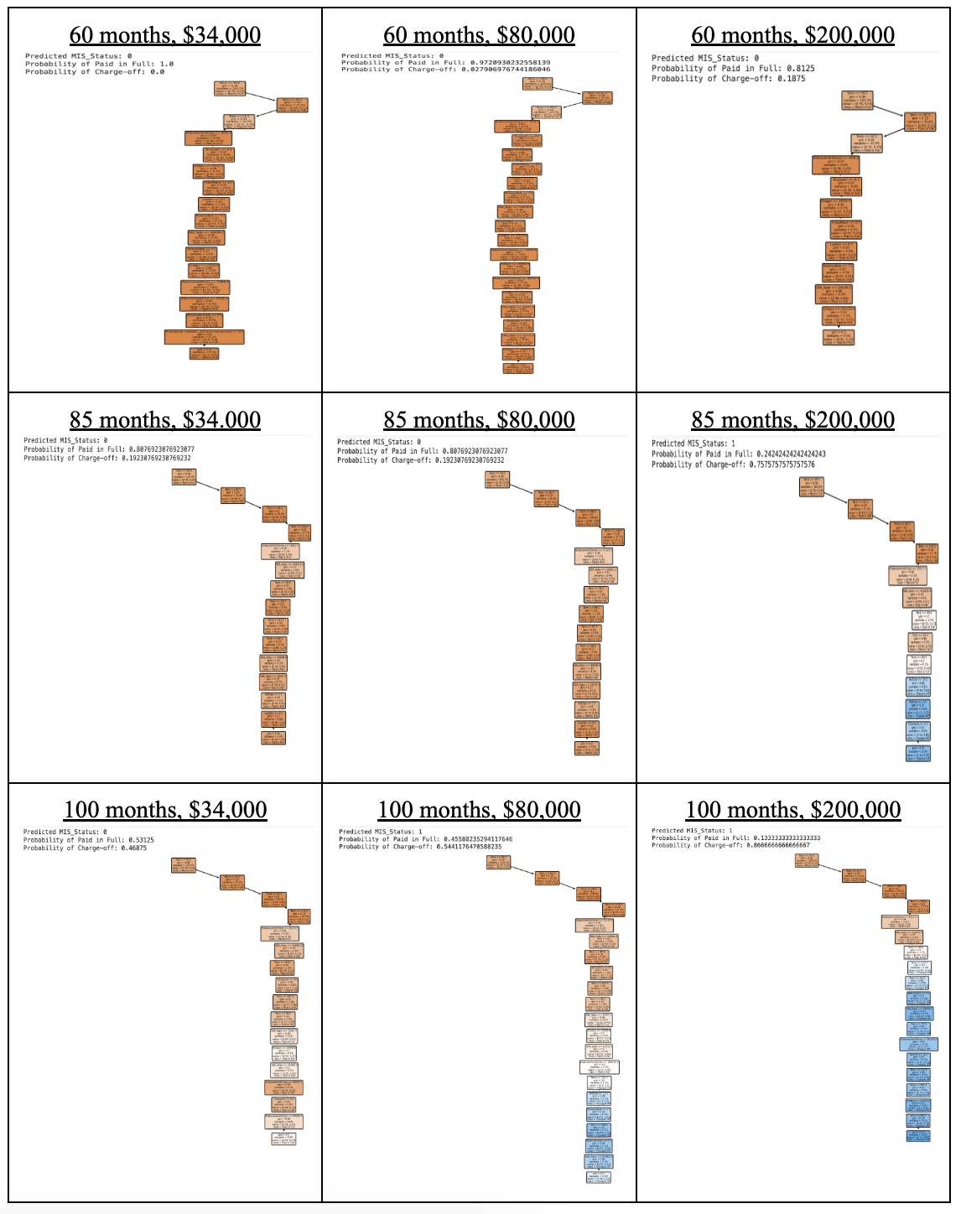
Examining Prediction Paths
Loans of around 60 months and $30,000 are most likely to be paid in full.
As these values get larger, so does the likelihood of defaulting.
Loans that are significantly smaller in term & amount tend to be charged off

Slide 28
06
Conclusion

Slide 29
Key Takeaways
Final Model
Our final chosen model is a decision tree with 93.4% accuracy and 85.8% recall. While it scores around 1% less than gradient boosting, it is more interpretable for business decision making purposes considering the tradeoff..
Loan Term
Shorter loan terms, like 60 months, are more likely to be paid in full. As the loan term gets longer, it becomes less clear whether the loan can be be paid in full.
Disbursement
Smaller disbursement amounts, like $50,000, are more likely to be paid in full. As the disbursement amount grows, it becomes more likely to be charged off.
Notes:
Eric

Slide 30
Possible ways to improve our models
Prune decision tree
Can further improve the decision tree with 92.8% accuracy and 82.3% recall. Current accuracy is approximately 1% lower than gradient boosting, but provides higher degree of interpretability.
Grid search for gradient boosting
Takes long time to run, tried different combinations of parameters without, but with more compute power we could derive more optimal combinations.
Neural Networks
Can result in higher accuracy, recall, and F1 score. However we would lose interpretability of model predictions for business decisions.
Notes:
Eric

Slide 31
Thank You !
Q&A

